Slide 1


Slide 2

An entity that has state and behavior is known as an object e.g. chair, bike, marker, pen, table, car etc. It can be physical or logical (tangible and intangible). The example of intangible object is banking system.

Slide 3
An object has three characteristics:
State: represents data (value) of an object.
Behavior: represents the behavior (functionality) of an object such as deposit, withdraw etc.
Identity: Object identity is typically implemented via a unique ID. The value of the ID is not visible to the external user. But, it is used internally by the JVM to identify each object uniquely.

Slide 4
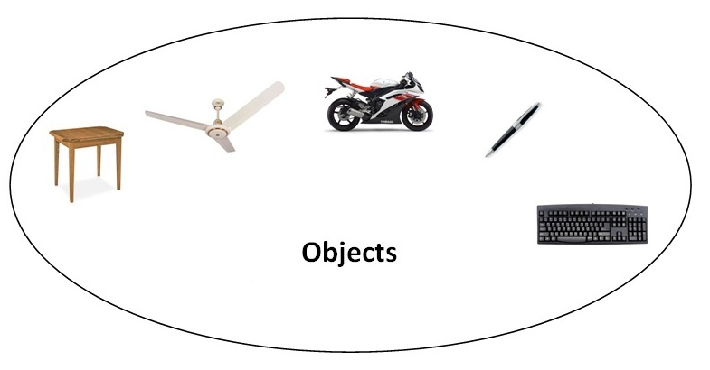
For Example: Pen is an object. Its name is Reynolds, color is white etc. known as its state. It is used to write, so writing is its behavior.

Slide 5
Object is an instance of a class. Class is a template or blueprint from which objects are created. So object is the instance(result) of a class.
Object Definitions:
Object is a real world entity.
Object is a run time entity.
Object is an entity which has state and behavior.
Object is an instance of a class.

Slide 6

A class is a group of objects which have common properties. It is a template or blueprint from which objects are created. It is a logical entity. It can't be physical.
A class in Java can contain:
fields
methods
constructors
blocks
nested class and interface

Slide 7
Syntax to declare a class:
class <class_name>
{
field;
method;
}

Slide 8

The new keyword is used to allocate memory at run time. All objects get memory in Heap memory area.

Slide 9

class Student
{
int id;//field or data member or instance variable
String name;
public static void main(String args[])
{
//creating an object of Student
Student s1=new Student( );
//accessing member through reference variable
System.out.println(s1.id);
System.out.println(s1.name);
}
}

Slide 10

There are 3 ways to initialize objects in java.
By reference variable
By method
By constructor

Slide 11

class Student
{ int id;
String name;
}
class TestStudent2
{ public static void main(String args[])
{ Student s1=new Student();
s1.id=101;
s1.name="Sonoo";
System.out.println(s1.id+" "+s1.name);
//printing members with a white space
}
}

Slide 12

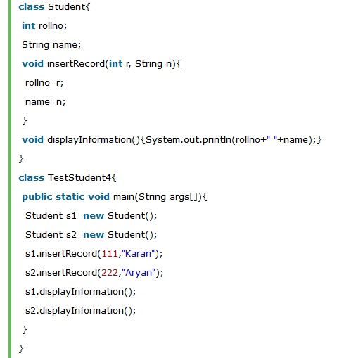

Slide 13

